Slide 1
gRPC APIs
Lecturer: Ngo Huy Bien
Software Engineering Department
Faculty of Information Technology
VNUHCM - University of Science
Ho Chi Minh City, Vietnam
nhbien@fit.hcmus.edu.vn

Slide 2

Objectives
To create a gRPC API.
To consume a gRPC API.

Slide 3

Contents
Binary Encoding vs. Text Encoding.
Serialization and Deserialization.
Text Protocol vs. Binary Protocol.
Protocol Buffers.
SOAP APIs vs. gRPC APIs.
RESTful APIs vs. gRPC APIs.
Node.js Demo.
Go Demo.

Slide 4

References
Jan Vanura and Pavel Kriz (2018). Perfomance Evaluation of Java, JavaScript and PHP Serialization Libraries for XML, JSON and Binary Formats.
Kasun Indrasiri and Danesh Kuruppu (2020). gRPC - Up & Running - Building Cloud Native Applications with Go and Java for Docker and Kubernetes. O'Reilly Media.
Barry Pollard (2019). HTTP/2 in Action. Manning Publications.
Thomas Hunter II (2021). Distributed Systems with Node.js. O'Reilly Media.
Travis Jeffery (2021). Distributed Services with Go: Your Guide to Reliable, Scalable, and Maintainable Systems. Pragmatic Bookshelf.

Slide 5
Binary Encoding vs. Text Encoding
Name: "ABC"
Age: 53
How to store the data in hard disk?
String (ASCII, UTF-8, Unicode) vs. Byte[].
int with the value 53 (4 bytes) instead of two characters '5' '3' (8 bytes).

Slide 6
Serialization
Programming language object (in memory) → JSON, Byte[].
https://learn.microsoft.com/en-us/dotnet/standard/serialization/
Serialization is the process of converting the state of an object into a form that can be persisted or transported.
The complement of serialization is deserialization, which converts a stream into an object.
Together, these processes allow data to be stored and transferred.

Slide 7
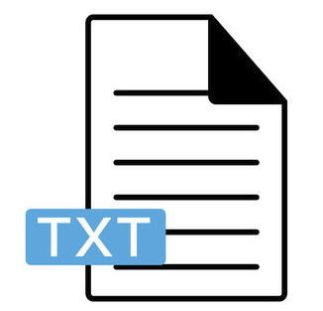
Example TEXT File Formats
.txt
.xml
.json
.js

Slide 8
JSON Serialization
JSON serialization serializes only public properties and does not preserve type fidelity.
System.Text.Json: Contains classes that can be used to serialize objects into JSON format documents or streams.

Slide 9
XML Serialization
XML serialization serializes only public properties and fields and does not preserve type fidelity.
System.Xml.Serialization: Contains classes that can be used to serialize objects into XML format documents or streams.

Slide 10
Saving an Object to Text File
Programming language data structures (objects)
↓
Text serialization
↓
Text format (XML, JSON)
↓
Text file

Slide 11
Binary Serialization
Binary serialization preserves type fidelity, which means that the complete state of the object is recorded and when you deserialize, an exact copy is created.
System.Runtime.Serialization: Contains classes that can be used for serializing and deserializing objects.

Slide 12

Example Binary File Formats
.jpg, .png, .gif
.zip
.exe
.dll
.bin
.class
.rtf, .doc
.pdf

Slide 13
Saving an Object to Binary File
Programming language data structures (objects)
↓
Binary serialization
↓
Binary format (Protobuf) or stream of bytes (010011)
↓
Binary file

Slide 14


Slide 15
Sending Object to Server
Programming language data structures (objects)
↓
Text serialization
↓
Text format (XML, JSON)
↓
Binary serialization
↓
Binary format or stream of bytes (010011)
↓
Server

Slide 16
Text Protocol vs. Binary Protocol
Text Response
HTTP/1.1 200 OK
Date: Mon, 19 Jan 1998 03:52:51 GMT
Server: Apache/1.2.4
Binary Response
struct response {
char protocolName[5];
int protocolVersion;
int responseType;
int status;
time_t date;
char host[1024];
}
responseType in the response structure is an int with the value 200 instead of three characters '2' '0' '0'.
A text based protocol is one that is designed to be communicated as a flat stream of (usually human-readable) lines of text, rather than as structured data of many different types.
The difference is really whether the protocol is oriented around data structures or around text strings.

Slide 18
Serialization and Deserialization [1]
In order to exchange the data between the client and the server (a Web service), it is necessary for the data to be transmitted in a format that is understood by both sides.
The process of converting data structures from a program code into these formats is called serialization or marshalling.
In general, it transforms the data into a stream of bytes, so a complex object can be saved into a file or sent via a network.
The reverse process is called deserialization or unmarshalling.
This is the process of converting a stream of bytes back into the programming language data structures.

Slide 19
Formats
XML (eXtensible Markup Language): text format defined by W3C (World Wide Web Consortium). Data are structured using elements and attributes.
JSON (JavaScript Object Notation): lightweight text format based on the JavaScript syntax, which often replaces XML due to XML's verbosity and size inefficiency.
Protocol Buffers or Protobuf: binary format developed by Google, that requires a pre-defined schema. This schema must be defined before the data serialization can be performed. The structure is defined in a .proto file, which is in a readable text format.

Slide 20
Serialization Helpers
PHP provides serialize() and unserialize() functions.
In Java, there are ObjectOutputStream and ObjectInputStream classes.
JavaScript provides JSON.stringify() and JSON.parse() functions to convert Object to JSON string.
JavaScript v8 library provides serialize and deserialize functions to convert Object to Buffer.

Slide 22
Protocol Buffers
https://protobuf.dev/overview/
Protocol Buffers are a language-neutral, platform-neutral extensible mechanism for serializing structured data.
Protocol buffers provide a serialization format for packets of typed, structured data that are up to a few megabytes in size.
The format is suitable for both ephemeral network traffic and long-term data storage.

Slide 23
Example Protocol Buffer Message
syntax = "proto3";
message SearchRequest {
string query = 1;
int32 page_number = 2;
int32 results_per_page = 3;
}
https://protobuf.dev/programming-guides/proto3/
Each field has a name and a type.
The given number must be unique among all fields. This number cannot be changed once your message type is in use because it identifies the field in the message wire format.

Slide 24
Protocol Buffer Wire Format
message Test1 {
optional int32 a = 1;
}
https://protobuf.dev/programming-guides/encoding/
n an application, you create a Test1 message and set a to 150. You then serialize the message to an output stream. If you were able to examine the encoded message, you’d see three bytes: 08 96 01
If you use the Protoscope tool to dump those bytes, you’d get something like 1: 150.

Slide 25
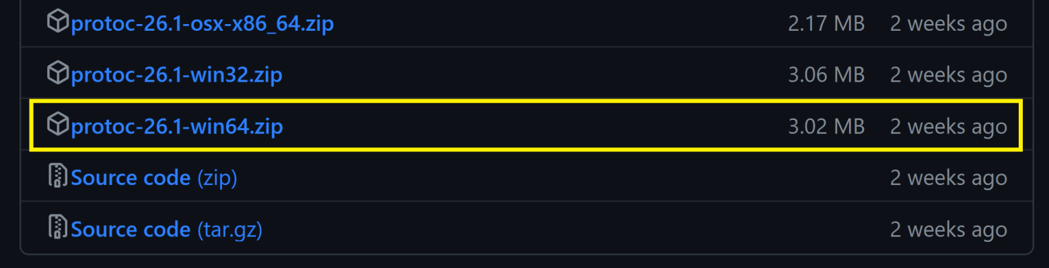
1. Download Protocol Buffer Compiler
https://github.com/protocolbuffers/protobuf/releases
Scroll down to Assets,
Click Show all link.
Click protoc-26.1-win64.zip link.

Slide 26
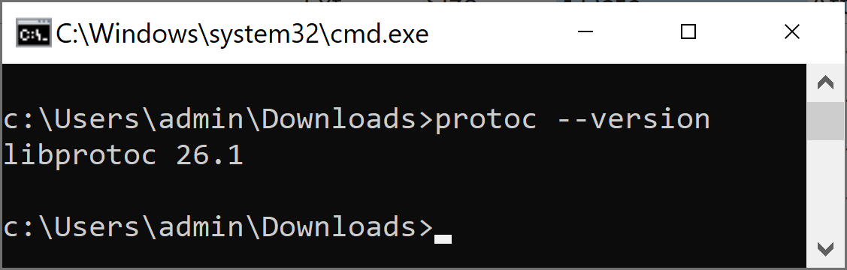
2. Verify Protocol Buffer Compiler Installation
Unzip protoc-3.20.0-win64.zip to C:\Users\admin\protoc.
Add C:\Users\admin\protoc\bin to PATH.
protoc --version

Slide 27
Protocol Buffer Compiler
https://protobuf.dev/programming-guides/proto3/
When you run the protocol buffer compiler on a .proto, the compiler generates the code in your chosen language you’ll need to work with the message types you’ve described in the file, including getting and setting field values, serializing your messages to an output stream, and parsing your messages from an input stream.
For C++, the compiler generates a .h and .cc file from each .proto, with a class for each message type described in your file.
For Java, the compiler generates a .java file with a class for each message type, as well as a special Builder class for creating message class instances.
For Go, the compiler generates a .pb.go file with a type for each message type in your file.
For C#, the compiler generates a .cs file from each .proto, with a class for each message type described in your file.

Slide 28
Protocol Buffer Compiler for Node.js
https://github.com/grpc/grpc-node/tree/master/examples

Slide 29
Why Protocol Buffers?
The advantages of using protobuf are that it:
Guarantees type-safety;
Prevents schema-violations;
Enables fast serialization; and
Offers backward compatibility.

Slide 31
What is gRPC? [2]
gRPC (the “g” stands for something different in every gRPC release) is an interprocess communication technology that allows you to connect, invoke, operate, and debug distributed heterogeneous applications as easily as making a local function call.

Slide 32
Why Not to Use Conventional RPC?
Examples
Common Object Request Broker Architecture (CORBA)
Java Remote Method Invocation (RMI)
Most such conventional RPC implementations are overwhelmingly complex, as they are built on top of communication protocols such as TCP, which hinders interoperability, and are based on bloated specifications.

Slide 33
Why Not to Use SOAP?
Simple Object Access Protocol is the standard communication technique in a service-oriented architecture (SOA) to exchange XML-based structured data between services.
The complexity of message format, as well as the complexities of specifications built around SOAP, hinders the agility of building distributed applications.

Slide 34
Why Not to Use REST?
Inefficient text-based message protocols
The client application (source) produces binary content to be sent to the server, then it converts the binary structure into text (because with HTTP 1.x you have to send textual messages) and sends it over the network in text (over HTTP) to a machine that parses and turns it back into a binary structure on the service (target) side.
Lacks strongly typed interfaces between apps
This leads to many incompatibilities, runtime errors, and interoperability issues.
REST architectural style is hard to enforce.
Most of the services that claim to be RESTful are not properly following the foundations of the REST style.
Development teams have to spend a lot of time maintaining the consistency and purity of a RESTful service.

Slide 35
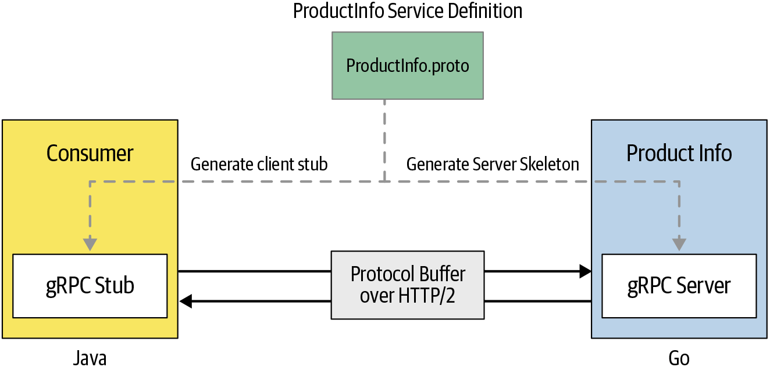
Example gRPC API
A microservice and a consumer based on gRPC:

Slide 36
Service Interface Definition
The service interface definition contains information on how your service can be consumed by consumers, what methods you allow the consumers to call remotely, what method parameters and message formats to use when invoking those methods, and so on.
The language that we specify in the service definition is known as an interface definition language (IDL).

Slide 37
Server Skeleton & Client Stub
Using that service definition, you can generate the server-side code (using the protocol buffer compiler protoc) known as a server skeleton, which simplifies the server-side logic by providing low-level communication abstractions.
Also, you can generate the client-side code, known as a client stub, which simplifies the client-side communication with abstractions to hide low-level communication for different programming languages.
The underlying gRPC framework handles all the complexities that are normally associated with enforcing strict service contracts, data serialization, network communication, authentication, access control, and observability.

Slide 39
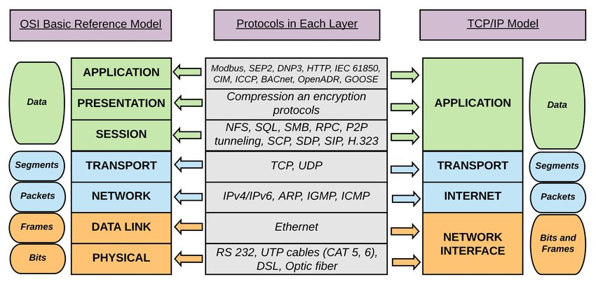
HTTP/2 Protocol
HTTP/2: https://www.rfc-editor.org/rfc/rfc9113.html

Slide 40
HTTP/2 vs. HTTP/1.1 [3]
HTTP/2 acts a lot like HTTP/1. It has the same methods (GET, POST, PUT, and so on); it uses the same URLs, the same response status codes (200, 404, 301, 302), and the same HTTP headers (mostly).
HTTP/2 is a more efficient way to make those same HTTP requests.
One of the main differences between HTTP/1 and HTTP/2 is that HTTP/2 is a binary, packet-based protocol, whereas HTTP/1 is entirely text-based.
HTTP/2 moves to a full binary protocol, in which HTTP messages are split and sent in clearly defined frames.
All HTTP/2 messages effectively use chunked encoding as standard, and this doesn’t need to be set explicitly.

Slide 41
HTTP/2 and Developers
In many ways, HTTP/2 is like HTTPS in that it effectively wraps standard HTTP messages in a special format before sending and unwraps them after receiving.
Therefore, although the client (web browser) and server (web server) need to know the exact details to send messages back and forth, higher-level applications don’t need to treat these versions too differently, because the underlying concepts of HTTP that they use are similar.
The binary representation of HTTP/2 is for the sending and receiving of messages, but the messages themselves are similar to older HTTP/1 messages. The binary framing usually is handled by the lower-level client or libraries (web browser or web server).

Slide 42

Implementation Steps
Select a platform.
Select a framework.
Import HTTP/2 server and support libraries.
Create .proto file.
Generate server skeleton and client stub from .proto file using protoc compiler.
Implement API functions.
Implement routing for each URL (map URLs to API functions).
Start local API server.
Invoke local APIs.
Deploy APIs to production server.
Invoke production APIs.

Slide 44
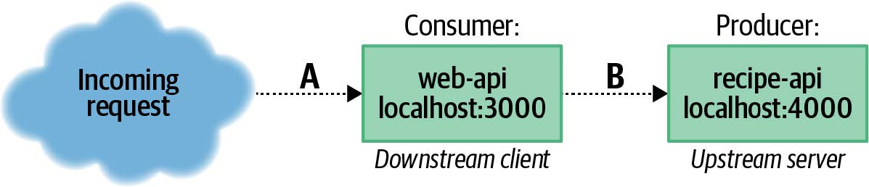
1. Create Project Structure [4]
mkdir recipe-api
cd recipe-api
npm init -y
cd ..
mkdir web-api
cd web-api
npm init -y
cd ..
mkdir shared

Slide 45
2. Create shared/grpc-recipe.proto (I)
syntax = "proto3";
package recipe;
service RecipeService { // A definition for a service named RecipeService.
rpc GetRecipe(RecipeRequest) returns (Recipe) {}
rpc GetMetaData(Empty) returns (Meta) {}
}
message Recipe { // A message of type Recipe.
int32 id = 1; // A field named id that can be a 32-bit integer.
string name = 2;
string steps = 3;
repeated Ingredient ingredients = 4; // An array of Recipe messages
// in a field named ingredients, the fourth entry for this message.
}

Slide 46
2. Create shared/grpc-recipe.proto (II)
message Ingredient {
int32 id = 1;
string name = 2;
string quantity = 3;
}
message RecipeRequest {
int32 id = 1;
}
message Meta {
int32 pid = 1;
}
message Empty {}

Slide 47
3. Create recipe-api/recipe-api.js (I)
#!/usr/bin/env node
// npm install @grpc/grpc-js@1.1 @grpc/proto-loader@0.5
const grpc = require('@grpc/grpc-js');
const loader = require('@grpc/proto-loader');
const path = require('path');
// The producer needs access to the .proto file.
// In this case it's loaded and processed when started, incurring a small startup cost.
const pkg_def = loader.loadSync(path.join(__dirname, '..', '/shared/grpc-recipe.proto'));
const recipe = grpc.loadPackageDefinition(pkg_def).recipe;

Slide 48
3. Create recipe-api/recipe-api.js (II)
const HOST = process.env.HOST || '127.0.0.1';
const PORT = process.env.PORT || 4000;
const server = new grpc.Server();
server.addService(recipe.RecipeService.service, { // When a service is defined,
// an object is provided with properties reflecting the methods
// defined in the .proto file.
getMetaData: (_call, cb) => { // This method correlates with
// the GetMetaData(Empty) method in the .proto definition.
cb(null, {
pid: process.pid,
});
},

Slide 49
3. Create recipe-api/recipe-api.js (III)
getRecipe: (call, cb) => { // The getRecipe() method makes use of an object
// passed in during the request. This object is provided as call.request.
if (call.request.id !== 42) {
return cb(new Error(`unknown recipe ${call.request.id}`));
}
cb(null, {
id: 42, name: "Chicken Tikka Masala",
steps: "Throw it in a pot...",
ingredients: [
{ id: 1, name: "Chicken", quantity: "1 lb", },
{ id: 2, name: "Sauce", quantity: "2 cups", }
]
});
},
});

Slide 50
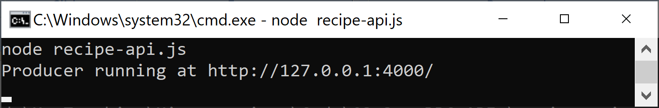
4. Run the recipe-api Service
cd recipe-api
npm install @grpc/grpc-js @grpc/proto-loader
node recipe-api.js

Slide 51


Slide 52
1. Create web-api/web-api.js (I)
#!/usr/bin/env node
// npm install @grpc/grpc-js@1.1 @grpc/proto-loader@0.5 fastify@3.2
const util = require('util');
const grpc = require('@grpc/grpc-js');
const server = require('fastify')();
const loader = require('@grpc/proto-loader');
const path = require('path');
// This one loads the .proto definitions at startup.
const pkg_def = loader.loadSync(path.join(__dirname, '..', '/shared/grpc-recipe.proto'));
const recipe = grpc.loadPackageDefinition(pkg_def).recipe;

Slide 53
2. Create web-api/web-api.js (II)
const HOST = '127.0.0.1';
const PORT = process.env.PORT || 3000;
const TARGET = process.env.TARGET || '127.0.0.1:4000';
const client = new recipe.RecipeService( // The gRPC client is aware that
// it is connecting to a recipe.RecipeService service.
TARGET,
grpc.credentials.createInsecure() // Security has been disabled.
);
const getMetaData = util.promisify(client.getMetaData.bind(client));
const getRecipe = util.promisify(client.getRecipe.bind(client));

Slide 54
3. Create web-api/web-api.js (III)
server.get('/', async () => {
const [meta, recipe] = await Promise.all([
getMetaData({}), // The GetMetaData() call makes use of
// an Empty message, which contains no properties.
getRecipe({ id: 42 }), // The GetRecipe() call, however,
// expects a RecipeRequest message.
// Here, an object adhering to the same shape is passed in.
]);
return {
consumer_pid: process.pid,
producer_data: meta,
recipe
};
});

Slide 55
4. Create web-api/web-api.js (IV)
server.listen(PORT, HOST, () => {
console.log(`Consumer running at http://${HOST}:${PORT}/`);
});

Slide 56
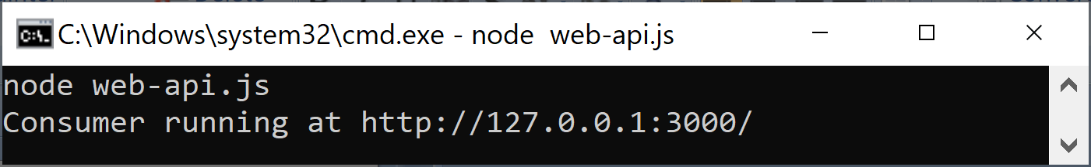
5. Run the web-api Service
cd web-api
npm install @grpc/grpc-js @grpc/proto-loader fastify
node web-api.js

Slide 57
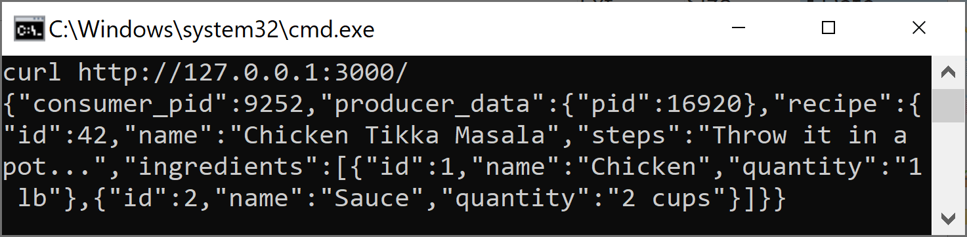
6. Invoke web-api Service
curl http://127.0.0.1:3000/

Slide 59
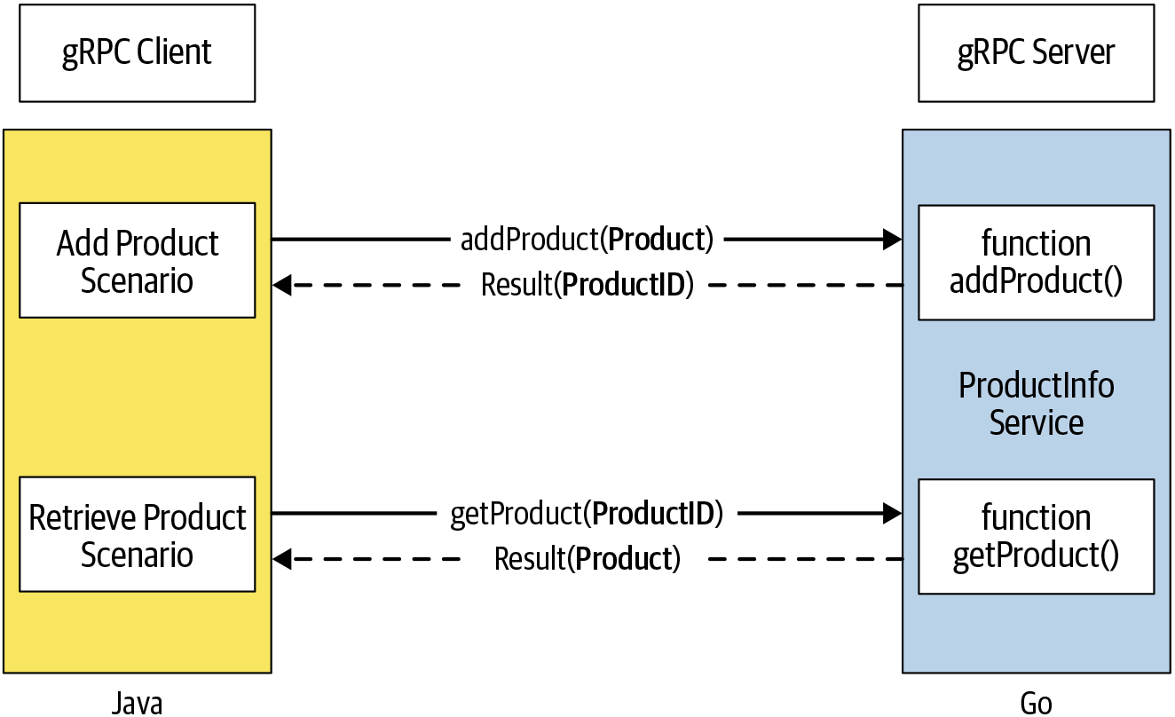
Hello World
We need to build a service that is responsible for managing the products of a retail store.
The service can be remotely accessed and the consumers of that service can add new products to the system and also retrieve product details from the system by providing the product ID.

Slide 60
1. Install Tools [1]
Install Go
https://go.dev/dl/
go version
Install Java
https://www.java.com/en/download/
java --version
Install Gradle
https://gradle.org/install/#manually
gradle -v
Install protoc
https://github.com/protocolbuffers/protobuf/releases/
protoc --version

Slide 61
2. Create Service Definition Folder
mkdir productinfo
mkdir proto
cd proto

Slide 62
3. Create product_info.proto
The ProductInfo service has two remote methods: addProduct(product) and getProduct(productId).
According to the protocol buffer rule, we can only have one input parameter in a remote method and it can return only one value.
syntax = "proto3";
package ecommerce;
option go_package = "/ecommerce";
service ProductInfo {
rpc addProduct(Product) returns (ProductID);
rpc getProduct(ProductID) returns (Product);
}
message Product {
string id = 1;
string name = 2;
string description = 3;
float price = 4;
}
message ProductID {
string value = 1;
}
Product is a custom message type.
Here the number assigned to each message field is used to uniquely identify the field in the message.
ProductID is a unique identifier of the product that can be a string value.

Slide 63
4. Create a Go Module
cd productinfo
mkdir service
cd service
go mod init productinfo/service
mkdir ecommerce

Slide 64
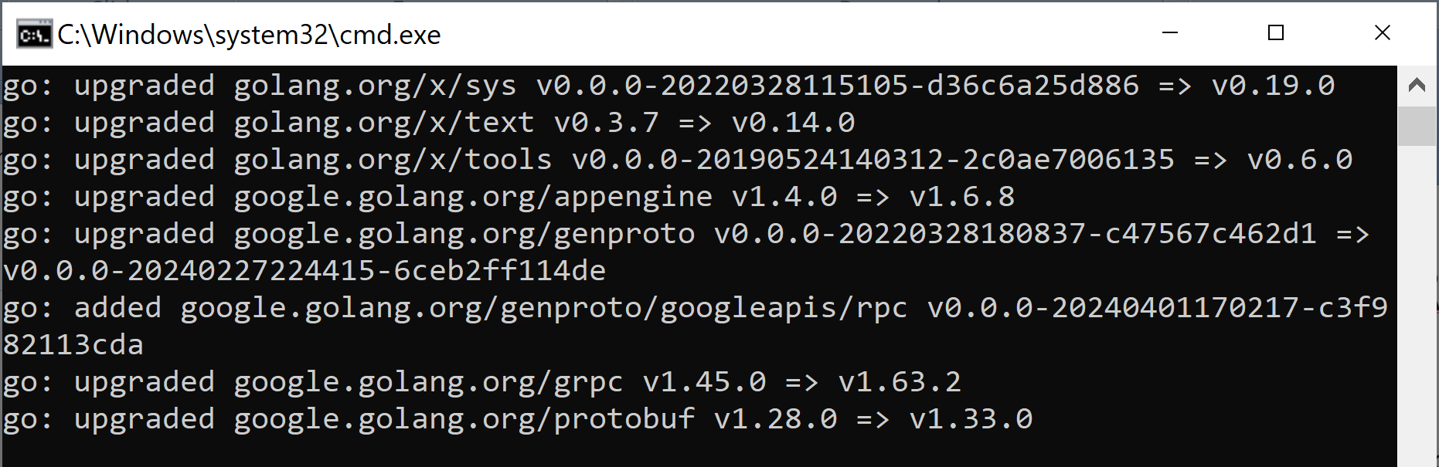
5. Install the gRPC Library
cd service
go get -u google.golang.org/grpc

Slide 65
6. Install the protoc Plug-in for Go
https://grpc.io/docs/languages/go/quickstart/
cd service
go install google.golang.org/protobuf/cmd/protoc-gen-go@v1.28
go install google.golang.org/grpc/cmd/protoc-gen-go-grpc@v1.2

Slide 66

Generate Server Skeleton & Client Stub
We'll use Gradle to build the Java application and use the Gradle protocol buffer plug-in to generate the service and client code.
For the Go application, we'll use the protocol buffer compiler and generate the code.

Slide 67
7. Generate Server Stub
https://grpc.io/docs/languages/go/quickstart/
cd productinfo
protoc -I proto/ proto/product_info.proto --go_out=service --go-grpc_out=service
proto/: The directory path where the source proto file and dependent proto files exist
proto/product_info.proto: The proto file path you want to compile.
--go_out=service and --go-grpc_out=service: The destination directory where you want the generated code to go.
The product_info.pb.go file and product_info_grpc.pb.go file will be generated inside the given subdirectory (ecommerce) in the module due to below content of the product_info.proto file.
syntax = "proto3";
package ecommerce;
option go_package = "/ecommerce";

Slide 68
8. Create productinfo_service.go
package main
import (
"context"
pb "productinfo/service/ecommerce"
"github.com/gofrs/uuid"
"google.golang.org/grpc/codes"
"google.golang.org/grpc/status"
)
// server is used to implement ecommerce/product_info.
type server struct {
// See https://github.com/grpc/grpc-go/issues/3794
pb.UnimplementedProductInfoServer
productMap map[string]*pb.Product
}

Slide 69
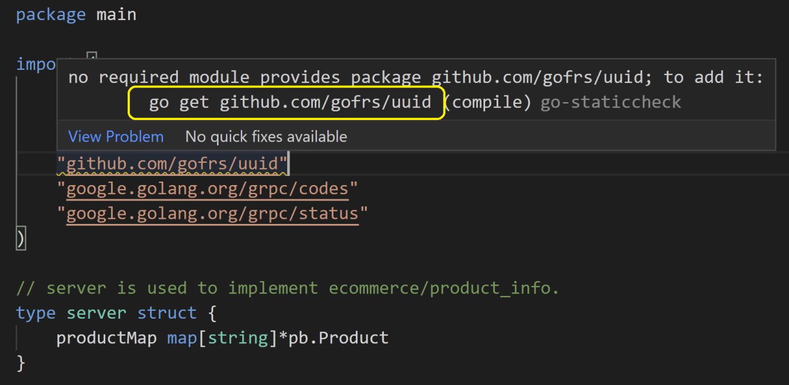
9. Install Package

Slide 70
10. Implement AddProduct Service
// AddProduct implements ecommerce.AddProduct
func (s *server) AddProduct(ctx context.Context,
in *pb.Product) (*pb.ProductID, error) {
out, err := uuid.NewV4()
if err != nil {
return nil, status.Errorf(codes.Internal,
"Error while generating Product ID", err)
}
in.Id = out.String()
if s.productMap == nil {
s.productMap = make(map[string]*pb.Product)
}
s.productMap[in.Id] = in
return &pb.ProductID{Value: in.Id}, status.New(codes.OK, "").Err()
}

Slide 71
11. Implement GetProduct Service
// GetProduct implements ecommerce.GetProduct
func (s *server) GetProduct(ctx context.Context,
in *pb.ProductID) (*pb.Product, error) {
value, exists := s.productMap[in.Value]
if exists {
return value, status.New(codes.OK, "").Err()
}
return nil, status.Errorf(codes.NotFound, "Product does not exist.", in.Value)
}

Slide 72
12. Create main.go
func main() {
lis, err := net.Listen("tcp", port)
if err != nil {
log.Fatalf("failed to listen: %v", err)
}
s := grpc.NewServer()
pb.RegisterProductInfoServer(s, &server{})
log.Printf("Starting gRPC listener on port " + port)
if err := s.Serve(lis); err != nil {
log.Fatalf("failed to serve: %v", err)
}
}

Slide 73
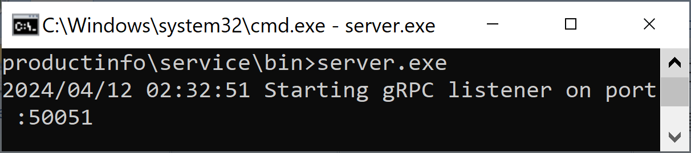
13. Build and Run Service
cd service
go build -v -o bin/server.exe
cd bin
server.exe

Slide 75
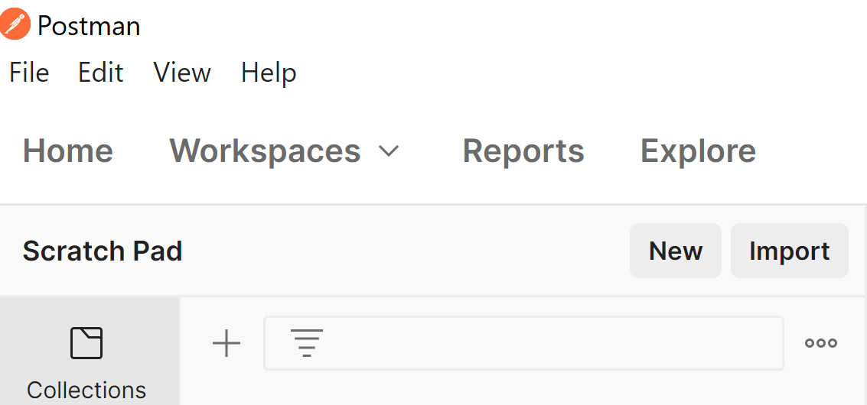
1. Create a Request
Open Postman, click on the New button.

Slide 76
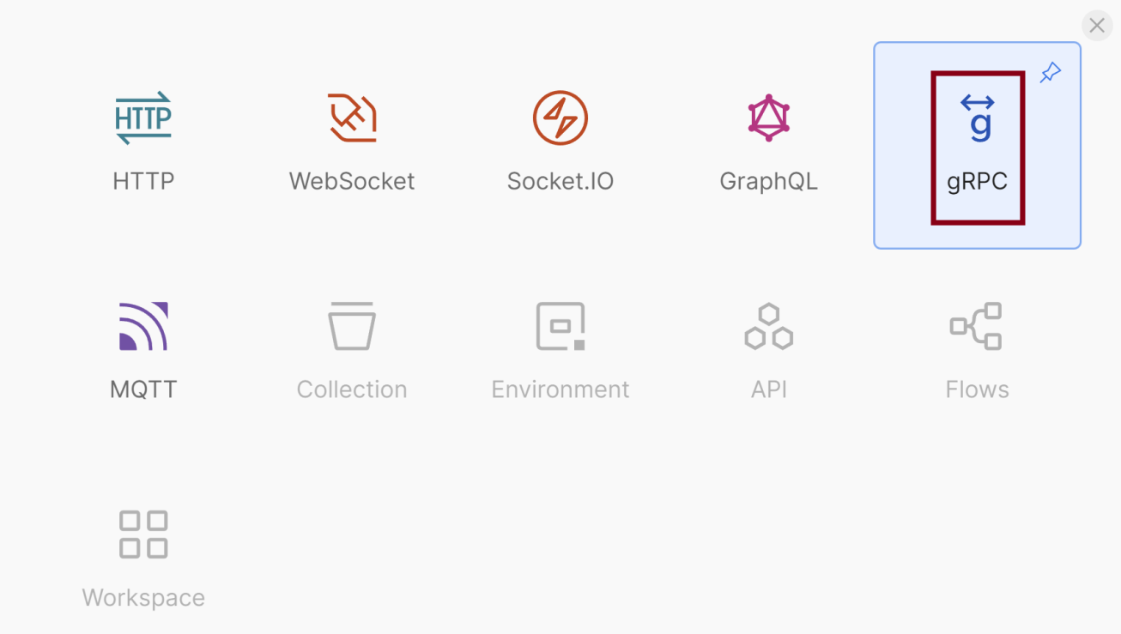
2. Select gRPC

Slide 77
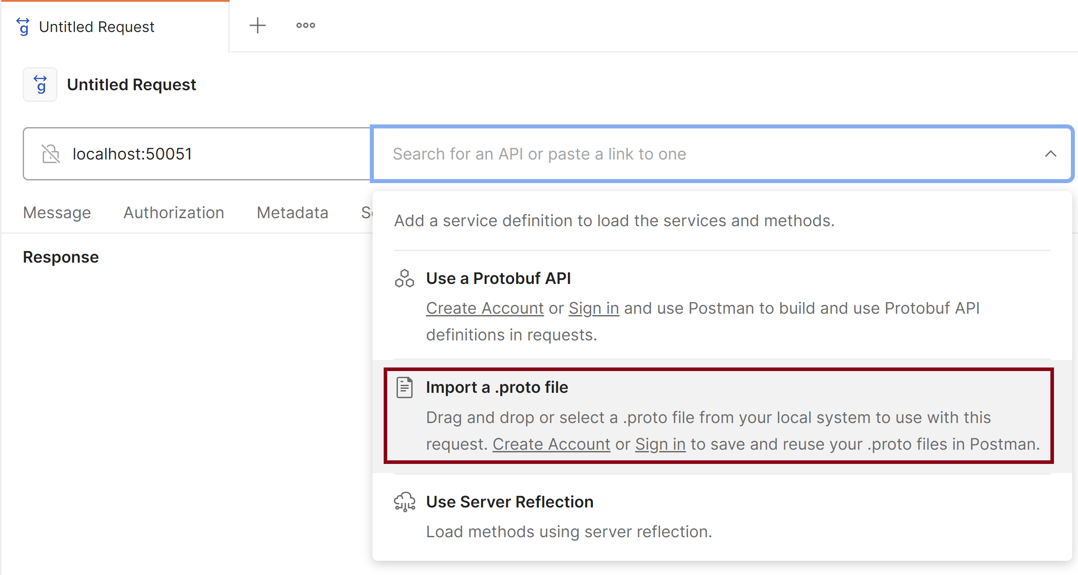
3. Import a .proto File

Slide 78
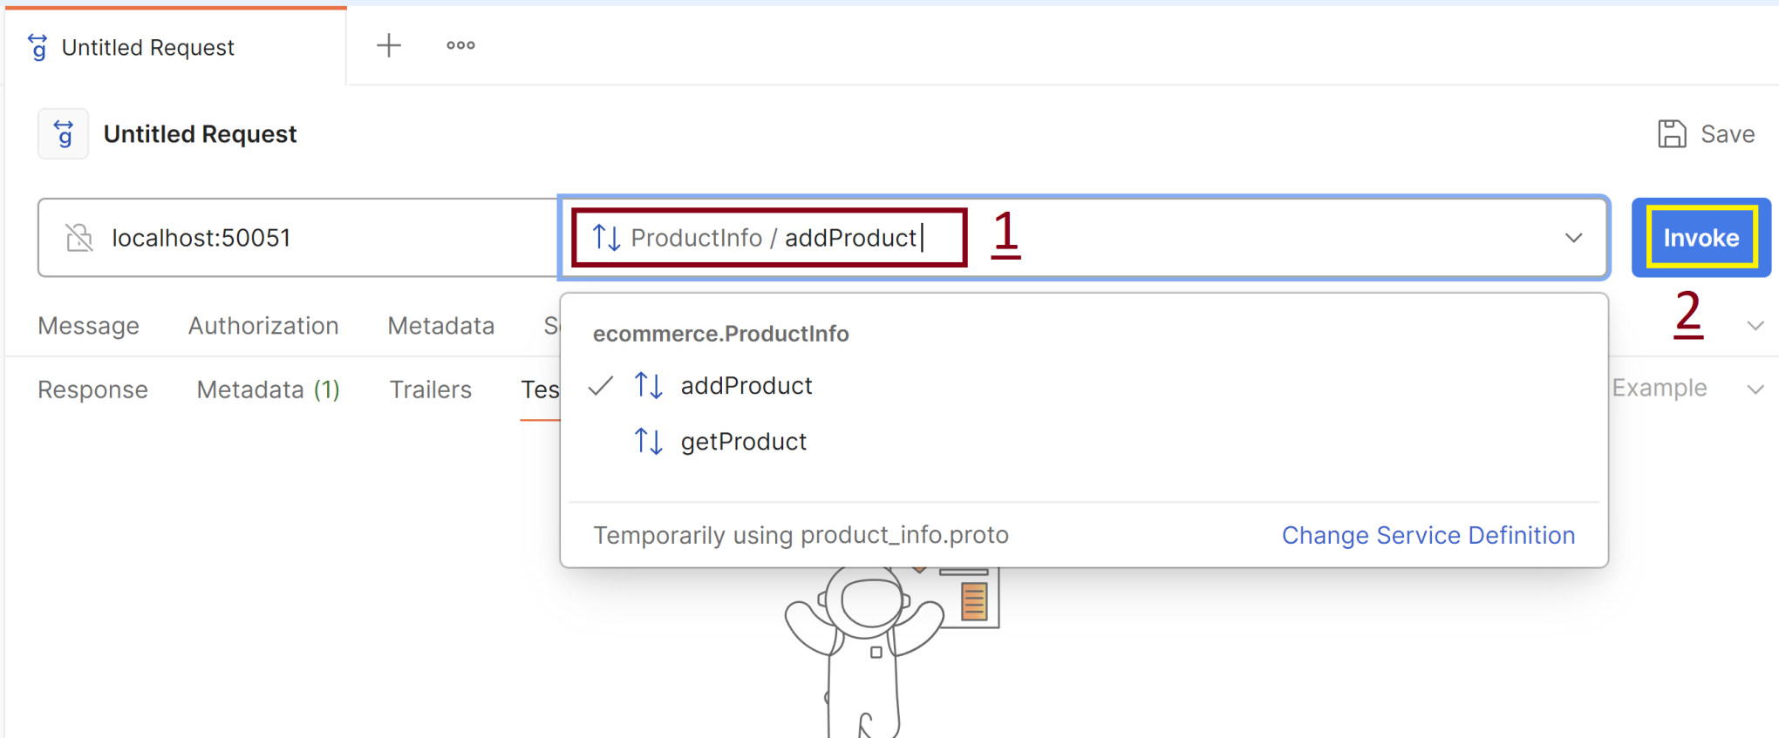
4. Select and Invoke a Method

Slide 80
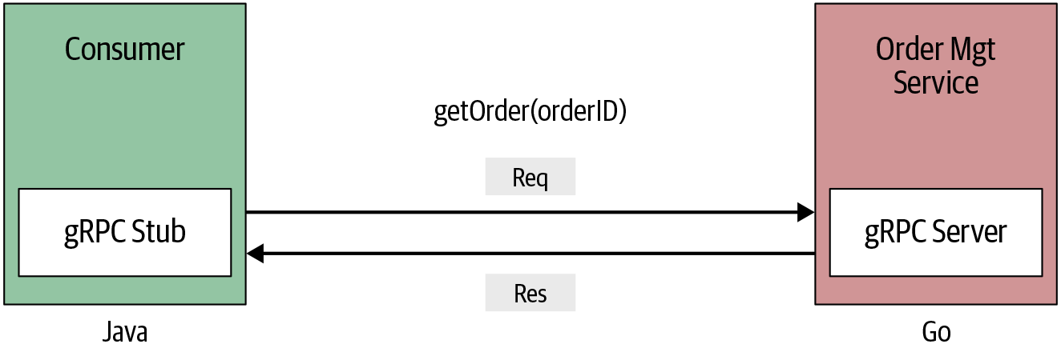
Simple RPC (Unary RPC) [2]
In simple RPC, when a client invokes a remote function of a server, the client sends a single request to the server and gets a single response that is sent along with status details and trailing metadata.

Slide 81
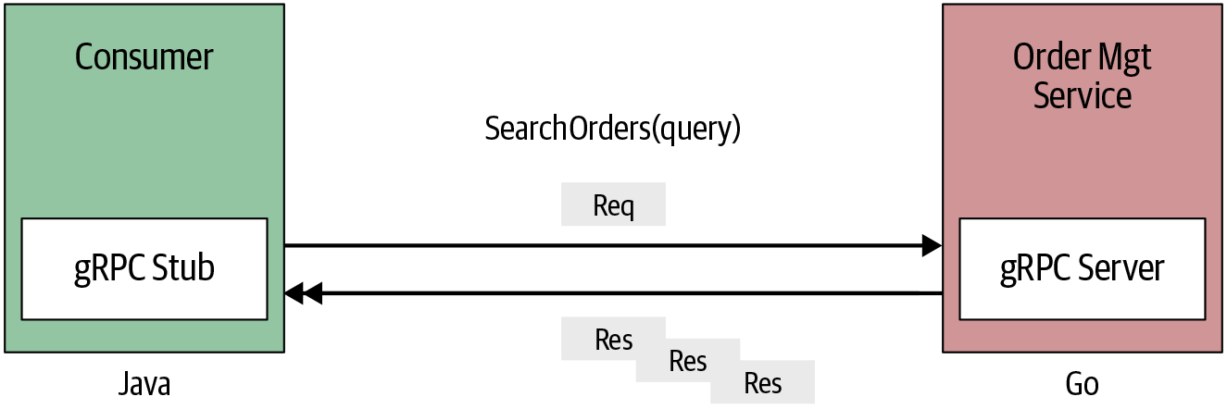
Server-Streaming RPC
In server-side streaming RPC, the server sends back a sequence of responses after getting the client’s request message.
This sequence of multiple responses is known as a “stream.” After sending all the server responses, the server marks the end of the stream by sending the server’s status details as trailing metadata to the client.

Slide 82
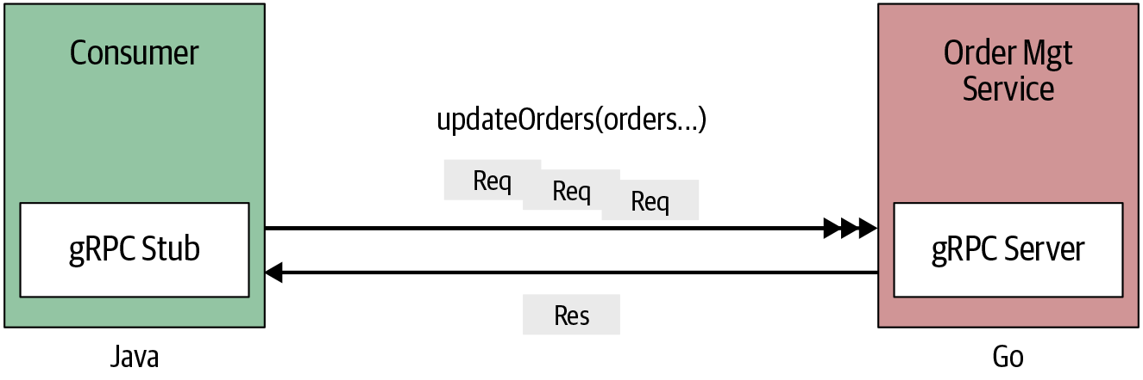
Client-Streaming RPC
In client-streaming RPC, the client sends multiple messages to the server instead of a single request. The server sends back a single response to the client.
However, the server does not necessarily have to wait until it receives all the messages from the client side to send a response.
Based on this logic you may send the response after reading one or a few messages from the stream or after reading all the messages.
Suppose you want to include a new method, updateOrders, in the OrderManagement service to update a set of orders

Slide 83
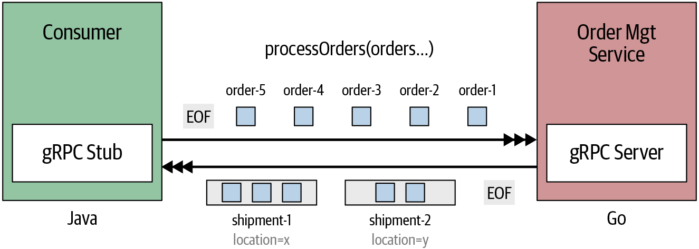
Bidirectional-Streaming RPC
In bidirectional-streaming RPC, the client is sending a request to the server as a stream of messages. The server also responds with a stream of messages.
The call has to be initiated from the client side, but after that, the communication is completely based on the application logic of the gRPC client and the server.
In our OrderManagement service use case, suppose we need order processing functionality where you can send a continuous set of orders (the stream of orders) and process them into combined shipments based on the delivery location.

Slide 84
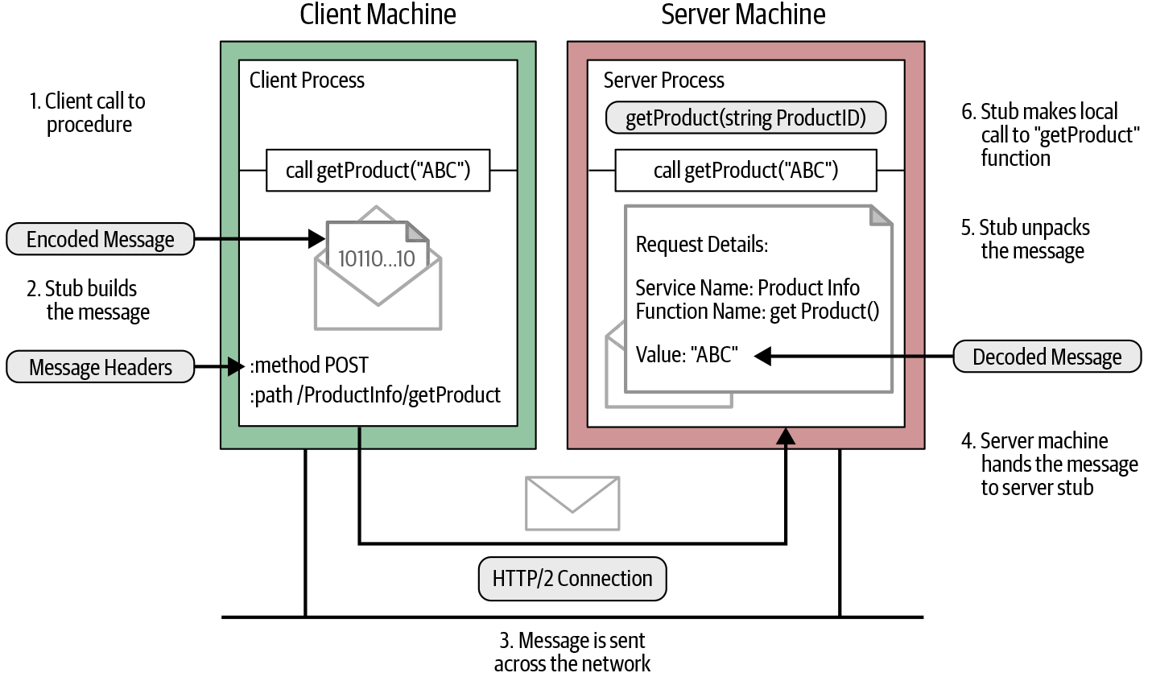
RPC Flow

Slide 86
1. Create Project Structure [5]
mkdir proglog
cd proglog
mkdir api
cd api
mkdir v1
cd v1
cd proglog
go mod init github.com/nhbien/api/log_v1

Slide 87
2. Create v1/log.proto
syntax = "proto3";
package log.v1;
option go_package = "github.com/nhbien/api/log_v1";
message Record {
bytes value = 1;
uint64 offset = 2;
}

Slide 88
3. Compile .proto File
https://grpc.io/docs/languages/go/quickstart/
cd proglog
protoc api/v1/*.proto --go_out=. --go_opt=paths=source_relative --proto_path=.
Look in the api/v1 directory and you'll see a new file called log.pb.go.
// Code generated by protoc-gen-go. DO NOT EDIT.
// versions:
// protoc-gen-go v1.26.0
// protoc v3.20.0
// source: api/v1/log.proto
package log_v1
import (
protoreflect "google.golang.org/protobuf/reflect/protoreflect"
...

Slide 89
4. Work with the Generated Code
Although the generated code in log.pb.go is a lot longer than your handwritten code in log.go (because of the extra code needed to marshal to the protobuf binary wire format), you'll use the code as if you'd handwritten it.
For example, you'll create instances using the & operator (or new keyword) and access fields using a dot.

Slide 91
How Logs Work
A log is an append-only sequence of records.
You append records to the end of the log, and you typically read top to bottom, oldest to newest.
Concrete implementations of logs have to deal with us not having disks with infinite space, which means we can't append to the same file forever. So we split the log into a list of segments.
When the log grows too big, we free up disk space by deleting old segments whose data we've already processed or archived.
This cleaning up of old segments can run in a background process while our service can still produce to the active (newest) segment and consume from other segments with no, or at least fewer, conflicts where goroutines access the same data.

Slide 92
Terminologies
Record—the data stored in our log.
Store—the file we store records in.
Index—the file we store index entries in.
Segment—the abstraction that ties a store and an index together.
Log—the abstraction that ties all the segments together.

Slide 93
1. Create Project Structure
cd proglog
mkdir internal
cd internal
mkdir log
cd log

Slide 94
2. Create log/config.go
package log
// We need to configure the max size
// of a segment's store and index.
type Config struct {
Segment struct {
MaxStoreBytes uint64
MaxIndexBytes uint64
InitialOffset uint64
}
}

Slide 95
3. Create log/store.go (I)
package log
import (
"bufio"
"encoding/binary"
"os"
"sync"
)
var (
enc = binary.BigEndian
)
const (
lenWidth = 8
)

Slide 96
4. Create log/store_test.go (I)
package log
import (
"io/ioutil"
"os"
"testing"
"github.com/stretchr/testify/require"
)
var (
write = []byte("hello world")
width = uint64(len(write)) + lenWidth
)

Slide 97
5. Create log/index.go (I)
package log
import (
"io"
"os"
"github.com/tysonmote/gommap"
)
var (
// The *Width constants define the number of bytes
// that make up each index entry.
offWidth uint64 = 4
posWidth uint64 = 8
// We use the entWidth to jump straight to the position
// of an entry given its offset
// since the position in the file is offset * entWidth.
entWidth = offWidth + posWidth
)

Slide 99
1. Create Project Structure
cd proglog
mkdir internal
cd internal
mkdir server
cd server

Slide 100
2. Create server/server.go (I)
syntax = "proto3";
package log.v1;
option go_package = "github.com/nhbien/api/log_v1";
message Record {
bytes value = 1;
uint64 offset = 2;
}
service Log {
rpc Produce(ProduceRequest) returns (ProduceResponse) {}
rpc Consume(ConsumeRequest) returns (ConsumeResponse) {}
rpc ConsumeStream(ConsumeRequest) returns (stream ConsumeResponse) {}
rpc ProduceStream(stream ProduceRequest) returns (stream ProduceResponse) {}
}

Slide 102

Further Reading

Slide 103

Thank You & See You Again

